Slide 1

Digital Electronic Systems
IY426
Combinational Basics
Mohammad Hosseinabady
Thursday 18-Jan-2022
mohammad@highlevel-synthesis.com

Slide 2
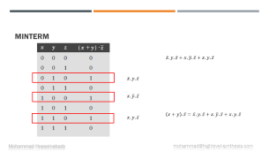
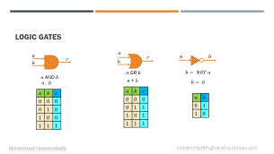
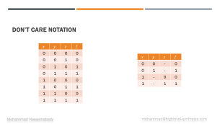
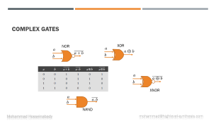
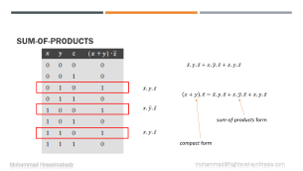

Slide 3


















































Logic Gates
$$a$$
$$a$$
$$c$$
$$c$$
$$a$$
$$b$$
$$b$$
$$b$$
$a$ OR $b$
$$b= NOT a$$
$a$ AND $b$
$a$ . $b$
$a$ + $b$
$$b= \overline{a}$$
$$a$$
$$b$$
$$c$$
$$a$$
$$b$$
$$c$$
$$0$$
$$0$$
$$0$$
$$a$$
$$b$$
$$0$$
$$0$$
$$0$$
$$0$$
$$1$$
$$1$$
$$0$$
$$1$$
$$0$$
$$1$$
$$0$$
$$1$$
$$0$$
$$1$$
$$1$$
$$0$$
$$1$$
$$0$$
$$0$$
$$1$$
$$1$$
$$1$$
$$1$$
$$1$$
$$1$$

Slide 4
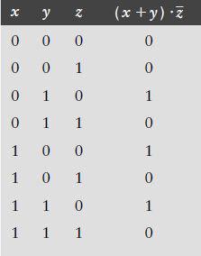
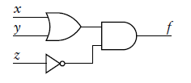

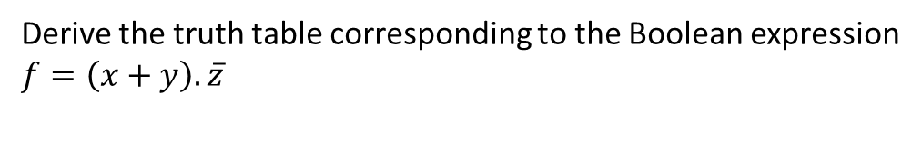
Boolean Expression
$$f=\left(x+y\right).\overline{z}$$
Derive the truth table corresponding to the Boolean expression
$$f=\left(x+y\right).\overline{z}$$

Slide 5





minterm
$$\overline{x}.y.\overline{z}+x.\overline{y}.\overline{z}+x.y.\overline{z}$$
$$\overline{x}.y.\overline{z}$$
$$x.\overline{y}.\overline{z}$$
$$x.y.\overline{z}$$
$$\left(x+y\right).\overline{z}=\overline{x}.y.\overline{z}+x.\overline{y}.\overline{z}+x.y.\overline{z}$$

Slide 6

sum-of-products
$$\overline{x}.y.\overline{z}+x.\overline{y}.\overline{z}+x.y.\overline{z}$$
$$\overline{x}.y.\overline{z}$$
$$\left(x+y\right).\overline{z}=\overline{x}.y.\overline{z}+x.\overline{y}.\overline{z}+x.y.\overline{z}$$
$$x.\overline{y}.\overline{z}$$
sum-of-products form
$$x.y.\overline{z}$$
compact form

Slide 7


sum-of-products
$$\left(x+y\right).\overline{z}=\overline{x}.y.\overline{z}+x.\overline{y}.\overline{z}+x.y.\overline{z}$$
$$\left(x+y\right).\overline{z}=x.\overline{z}+y.\overline{z}$$
optimization

Slide 8
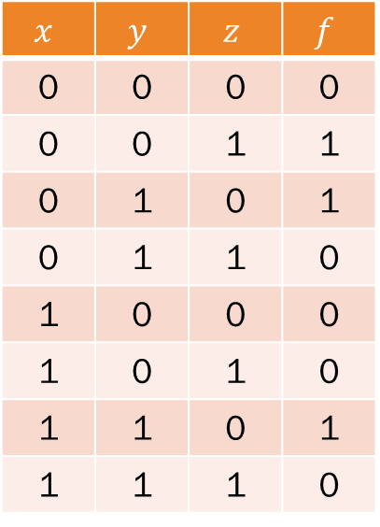
Quiz
Find minterms and sum-of-products
$$x$$ | $$y$$ | $$z$$ | $$f$$
0 | 0 | 0 | 0
0 | 0 | 1 | 1
0 | 1 | 0 | 1
0 | 1 | 1 | 0
1 | 0 | 0 | 0
1 | 0 | 1 | 0
1 | 1 | 0 | 1
1 | 1 | 1 | 0

Slide 9
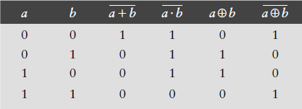












complex gates
NOR
XOR
$$a$$
$$a$$
$$\overline{a+b}$$
$$a⊕b$$
$$b$$
$$b$$
$$a$$
$$\overline{a⊕b}$$
$$b$$
XNOR
$$a$$
$$\overline{a.b}$$
$$b$$
NAND

Slide 10
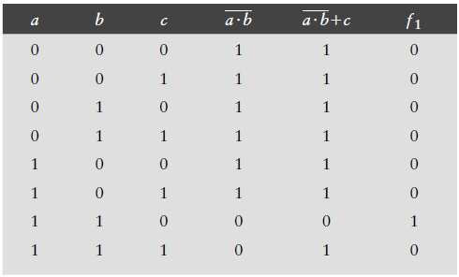
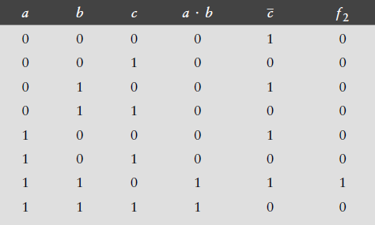


Quiz
Use truth tables to show that the following two Boolean functions are equivalent.
$$f_{1}=\overline{\overline{a.b}+c}$$
$$f_{2}=(a.b).\overline{c}$$

Slide 11
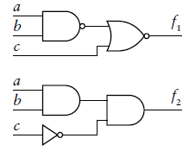


Quiz
Use logic gates to represent these functions.
$$f_{1}=\overline{\overline{a.b}+c}$$
$$f_{2}=(a.b).\overline{c}$$

Slide 12
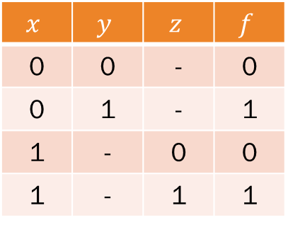
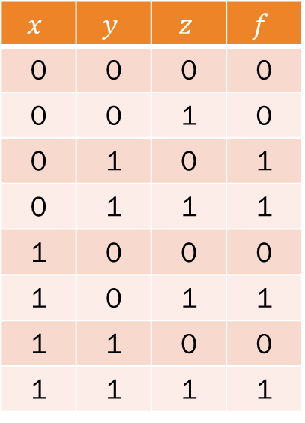
Don’t Care Notation
$$x$$ | $$y$$ | $$z$$ | $$f$$
0 | 0 | 0 | 0
0 | 0 | 1 | 0
0 | 1 | 0 | 1
0 | 1 | 1 | 1
1 | 0 | 0 | 0
1 | 0 | 1 | 1
1 | 1 | 0 | 0
1 | 1 | 1 | 1
$$x$$ | $$y$$ | $$z$$ | $$f$$
0 | 0 | - | 0
0 | 1 | - | 1
1 | - | 0 | 0
1 | - | 1 | 1

Slide 13
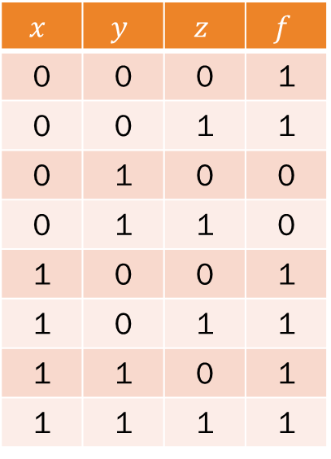
Quiz
Reduce the size of this truth table in by using the don’t care notation for inputs.
$$x$$ | $$y$$ | $$z$$ | $$f$$
0 | 0 | 0 | 1
0 | 0 | 1 | 1
0 | 1 | 0 | 0
0 | 1 | 1 | 0
1 | 0 | 0 | 1
1 | 0 | 1 | 1
1 | 1 | 0 | 1
1 | 1 | 1 | 1

Slide 14

Questions

